Slide 1


The Terminal Window

Slide 2

Agenda
What is a Terminal?
What is a Terminal Window
Different names
Why you should learn to use it / Disadvantages
How to open a (Bash) Terminal
Basic commands
Wrapping up

Slide 3
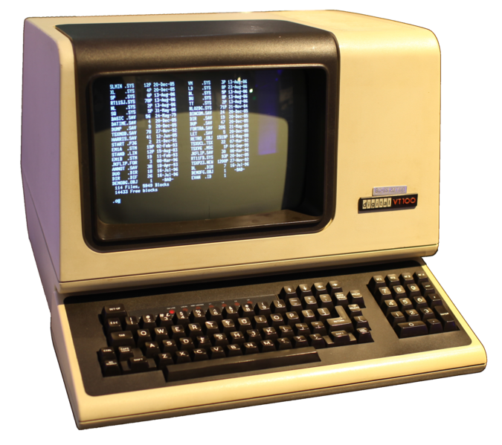
The Terminal - What is
T
A device (or combination of devices) that combines both input and output capabilities. Allows to communicate with a computer.
Combines an Input and output device (Usually: Keyboard - Monitor)

Slide 4
Types of Terminals
T
Dumb terminal: has no built-in data processing capabilities and serves only to send and receive data. No processing capabilities, connects directly to a host computer which is the one who performs the tasks.
Intelligent terminal: has substantial data processing capabilities due to inbuilt processor and memory. For example: Your own computer.

Slide 5
The Terminal Window
T
It is a window in a graphical interface that is used to display a command line for local or remote execution of a program. The terminal window is widely used by developers to perform operations in local and remote computers.

Slide 6

The Terminal Window
T

Slide 7
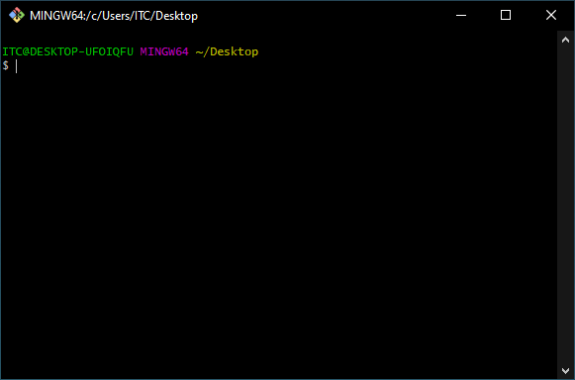
The Terminal Window
T
Why?
Because some programs that we are going to use during this course rely on terminal input, like Git or NodeJS.

Slide 8
Why you should learn it - Advantages
T
Efficiency: very fast to perform operations if you know what you want to do.
Lightweight: fewer system resources to implement than a GUI (Graphical User Interface).
Generic: once you learn the syntax, it can be used to execute commands in other devices that also use that type of command language.
Some programming and maintenance tasks may not have a graphical user interface and may still use a command line.

Slide 9
Disadvantages
T
Not as intuitive to use as a GUI (Graphical User Interface)
You need to know how to read what is going on
Requires practice to master it

Slide 10
The Terminal Window - Other names
T
CLI (Command Line Interface)
Shell (even though not all shells are CLIS)
Bash (It is one type of command line language for the Terminal, one of the most populars, but not the only one)

Slide 11
The Terminal Window - The language
T
For this course we are going to use Bash as our default Command Language. Mac OS X Catalina uses Zsh, which is a superset of Bash. It is ok to use that one.
Linux users are ok with the default.
Windows Users will need to download a Bash emulator like Git-Bash (or any other Unix Command Line Emulator) since windows natively uses other command line language (DOS)

Slide 12

Terminal - Bash (Unix Terminal)
T

Slide 13
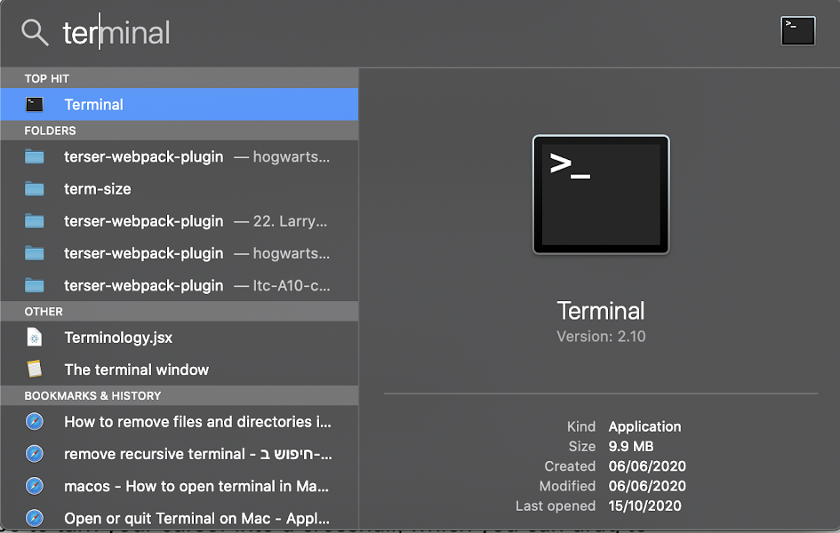
Opening a Terminal Window - MAC OS
T
Using Spotlight (⌘ + space):
Additionally, you can add to it a keyboard shortcut through the system settings.

Slide 14
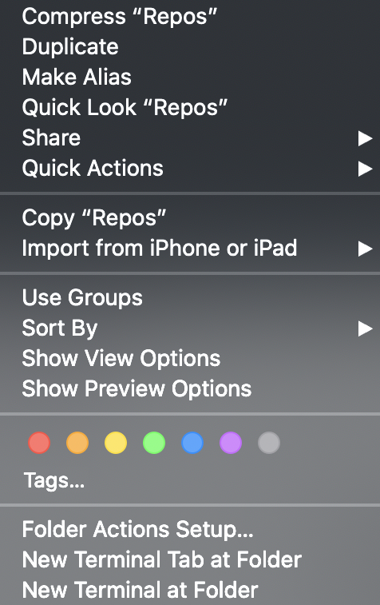
Opening a Terminal Window
at a specific folder - MAC OS
T
Right click at folder + New Terminal at Folder

Slide 15
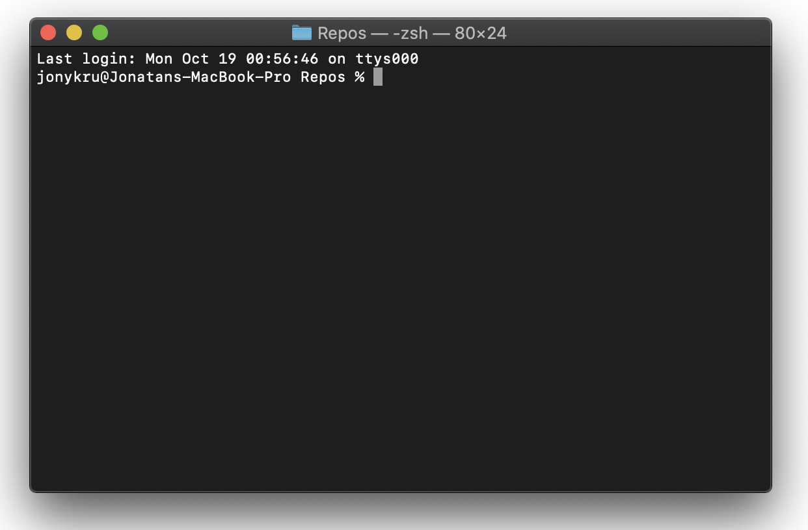
Opening a Terminal Window - MAC OS
T
Result:
Pay attention to the following:
- The first part is the user name, until the @.
- From the @, we have the computer name
- Afterwards, a space and the name of the folder.

Slide 16
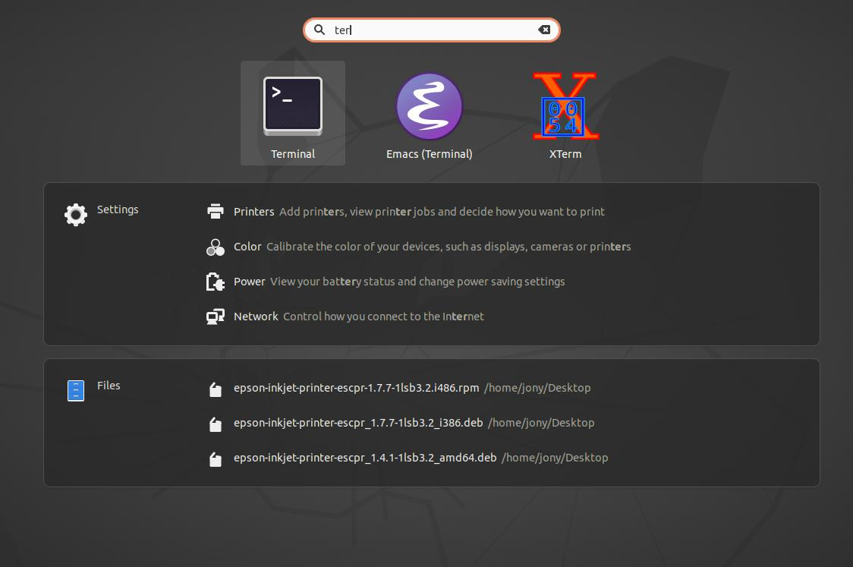
Opening a Terminal Window - Ubuntu
T
Using the Applications menu and searching for Terminal:

Slide 17
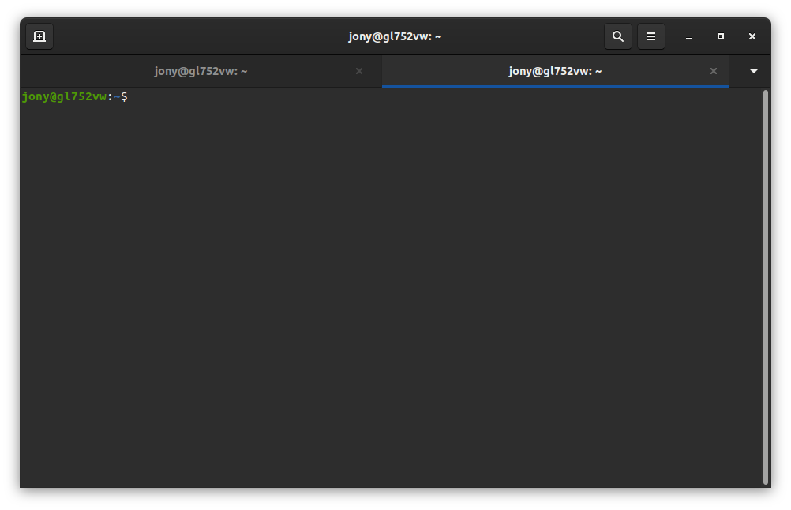
Opening a Terminal Window - Ubuntu
T
Using the keyboard shortcut CTRL + ALT + T:

Slide 18
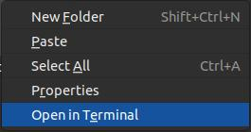
Opening a Terminal Window
at a specific folder - Ubuntu
T
Using Right Click + Open in Terminal at any folder

Slide 19
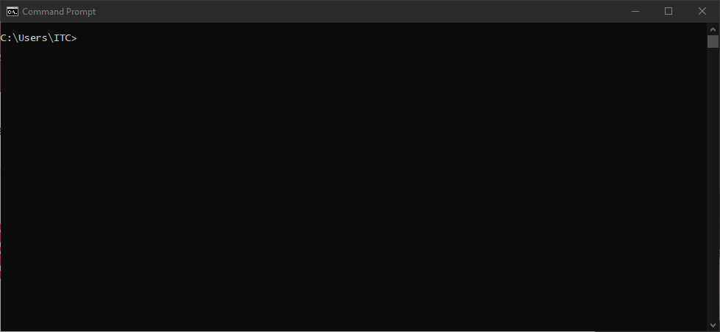
Opening a Terminal Window - Windows
T
CMD: (Command line prompt) Not a UNIX shell: despite that the Bash Command line language can be installed and used with the CMD, it is advisable to use a Unix Emulator like Git Bash.
We are not going to use it. 👎

Slide 20
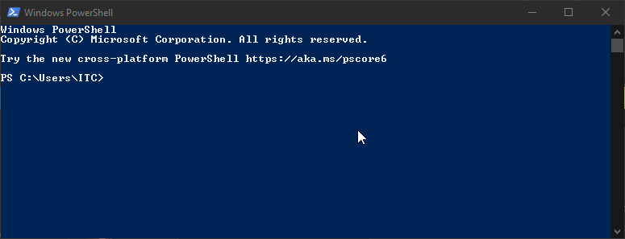
Opening a Terminal Window - Windows
T
PowerShell: Not a UNIX shell: despite that the Bash Command line language can be installed and used with PowerShell, it is advisable to use a Unix Emulator like Git Bash.
We are not going to use it. 👎

Slide 21

Opening a Terminal Window - Windows
T
Git Bash: Unix Shell for windows 👍, but you will need to install it.
Access it from the programs menu or through a shortcut in your desktop

Slide 22
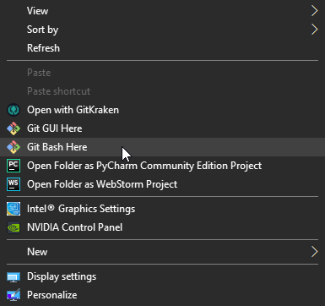
Opening a Terminal Window at a specific folder - Windows
T
How to open: Right click at any folder and ‘Git Bash Here’.

Slide 23
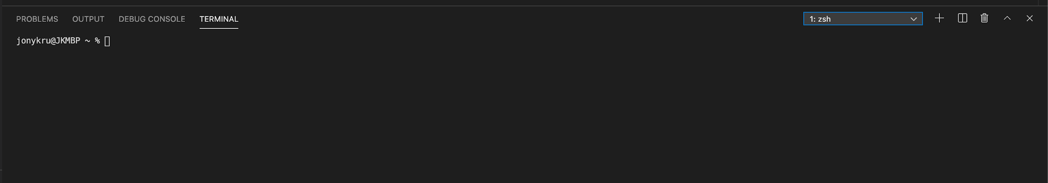
Opening a Terminal Window - VSC
T
Visual Studio Code also has a terminal incorporated.
Go to View > Terminal. The shortcut is CTRL + ` (the button to the left of the 1)
Make sure that in the dropdown menu you have zsh or bash as the command line language! (Specially Windows Users)

Slide 24
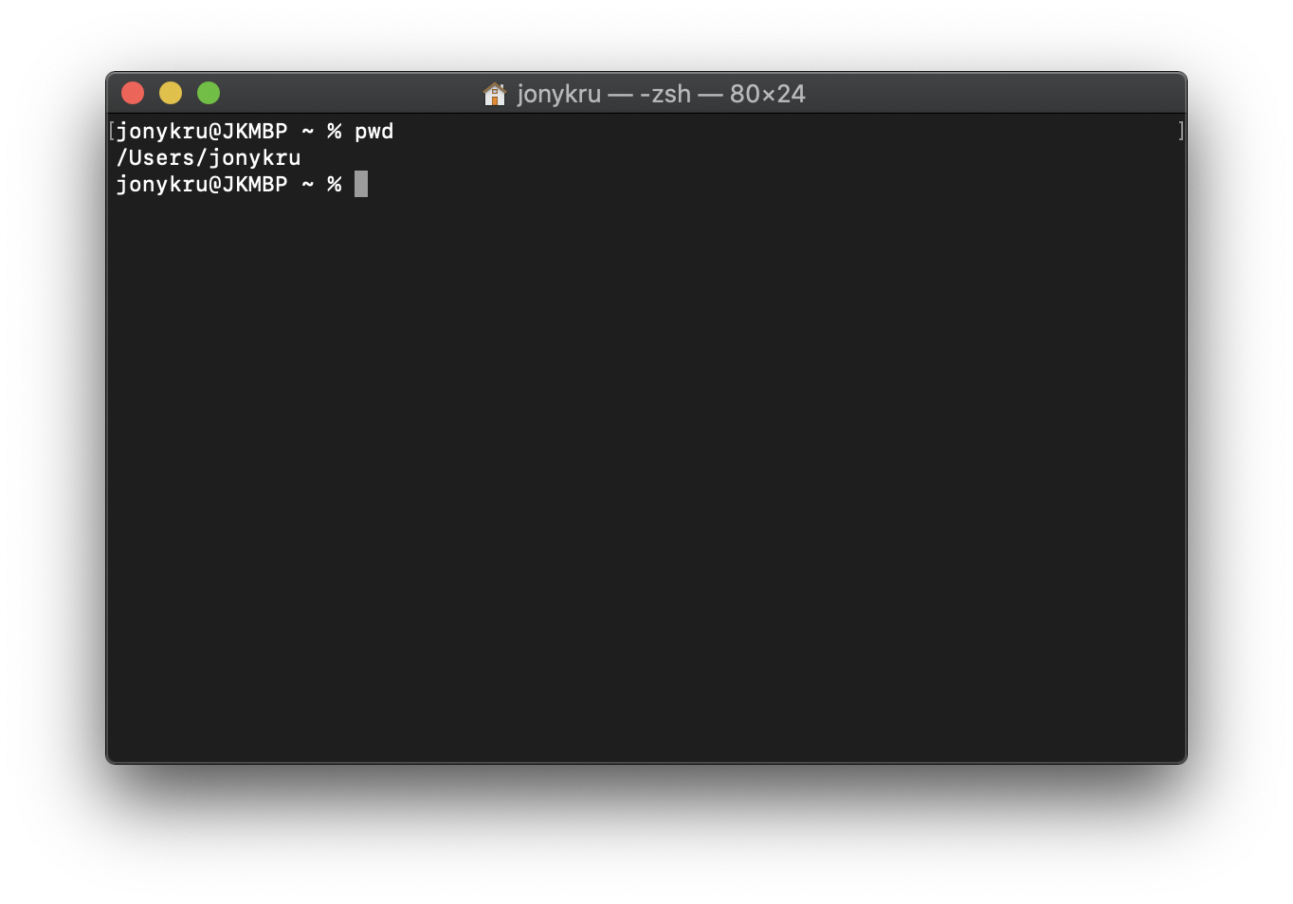
Basic Commands - pwd
T
pwd: print work directory. Shows your current location.
The ~ means Home directory.
That means that in this case, the home directory is in /Users/jonykru

Slide 25
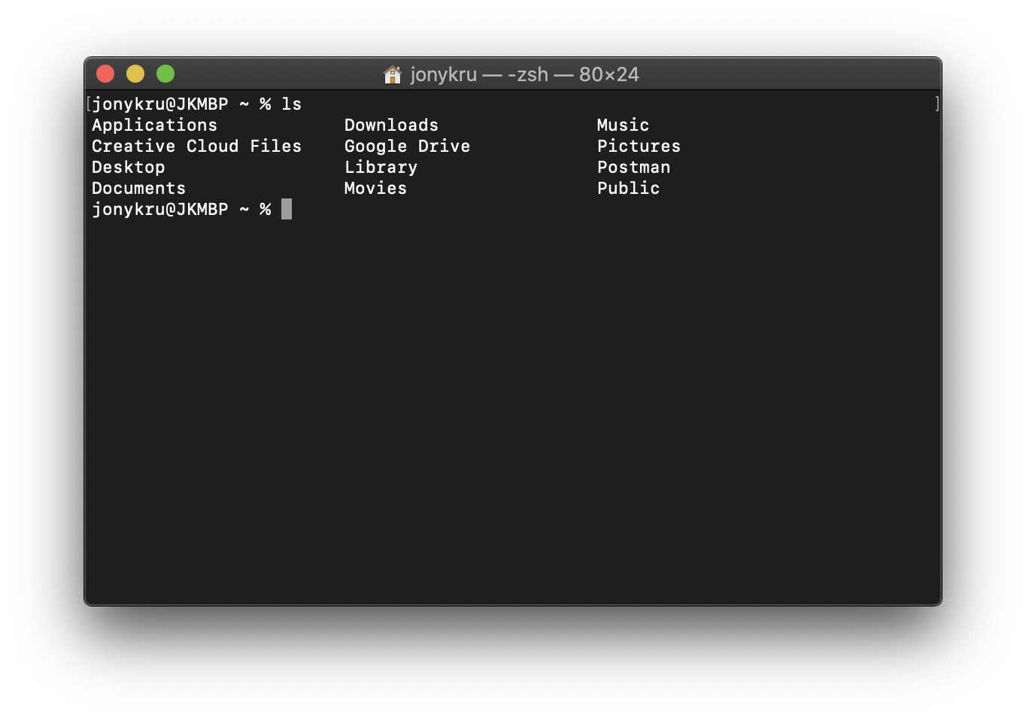
Basic Commands - ls
T
ls: lists the directories and files in the current location.

Slide 26
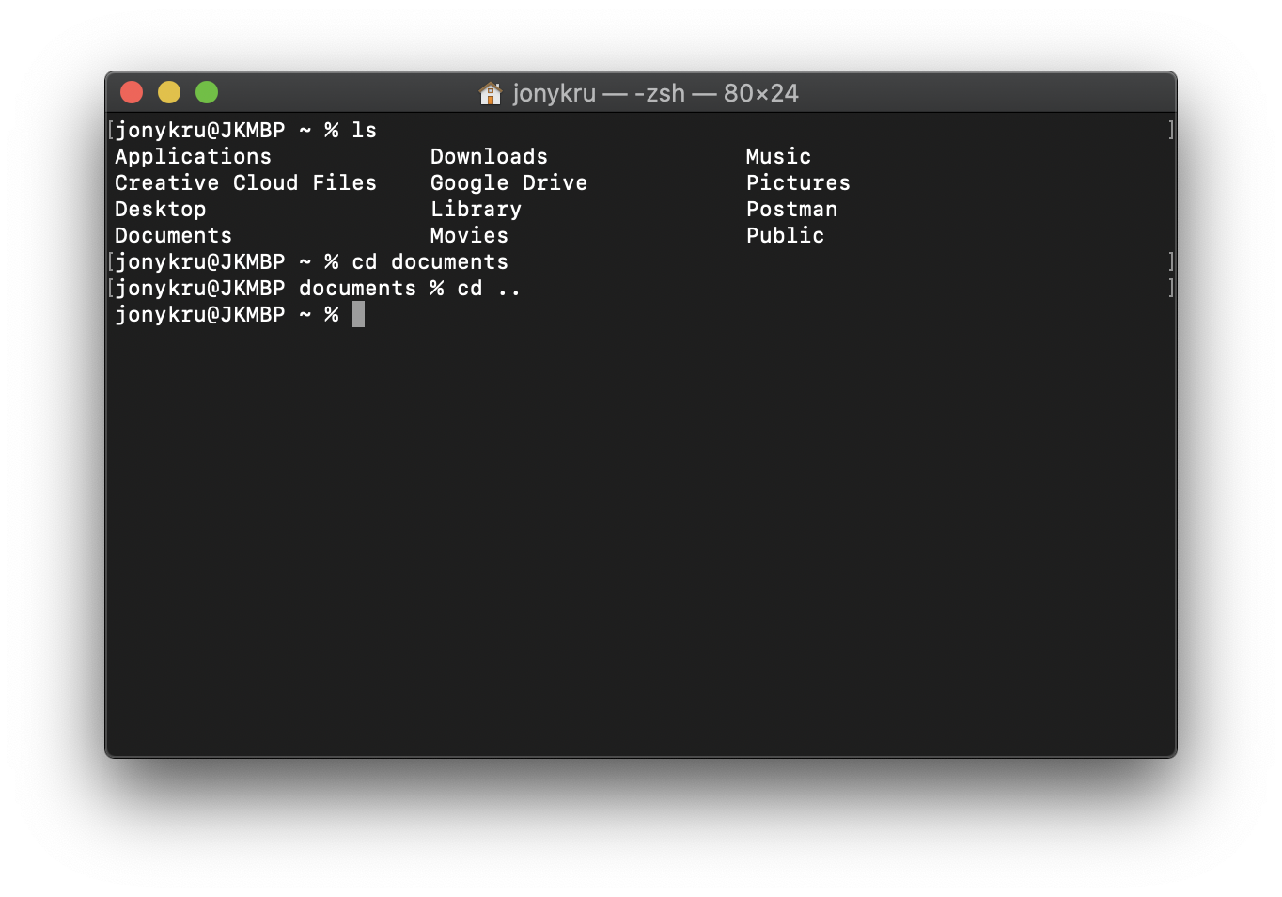
Basic Commands - cd
T
cd: changes directory. You can go on folder down by adding the name of the directory that you want to access or go a folder up by doing cd ..
Going two folders up?
cd ../..

Slide 27
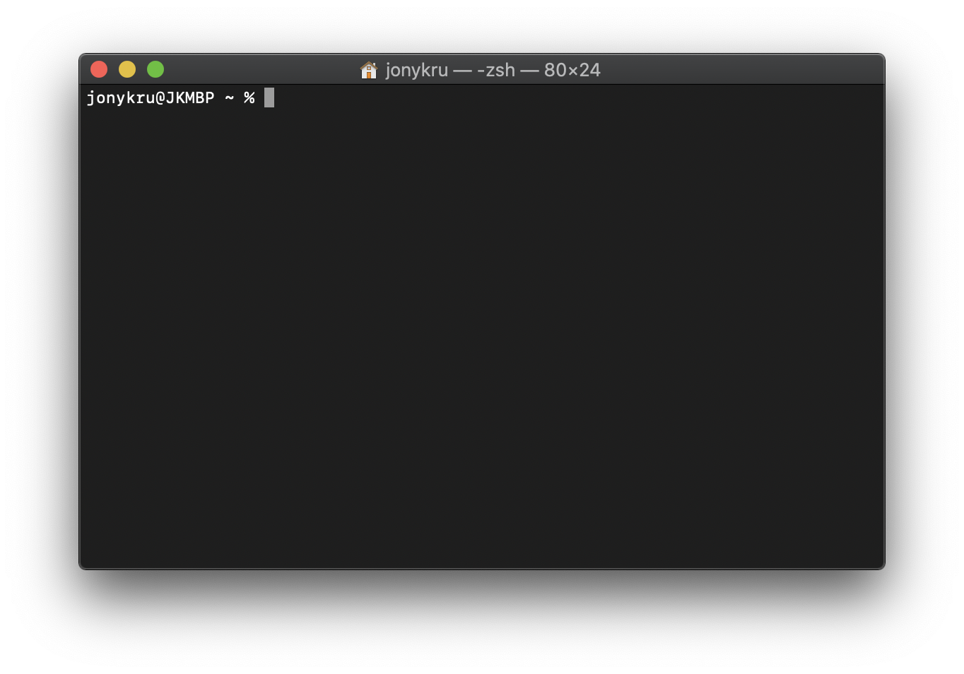
Basic Commands - clear
T
clear: clears the screen

Slide 28
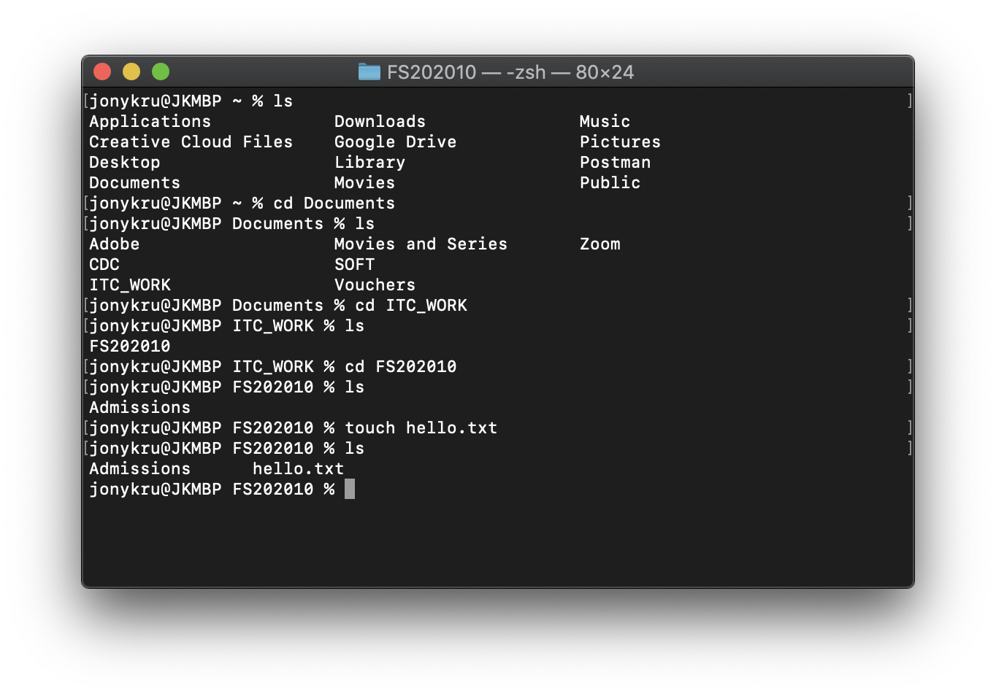
Basic Commands - touch
T
touch: creates a file.
As you can see, hello.txt didn’t exist before

Slide 29
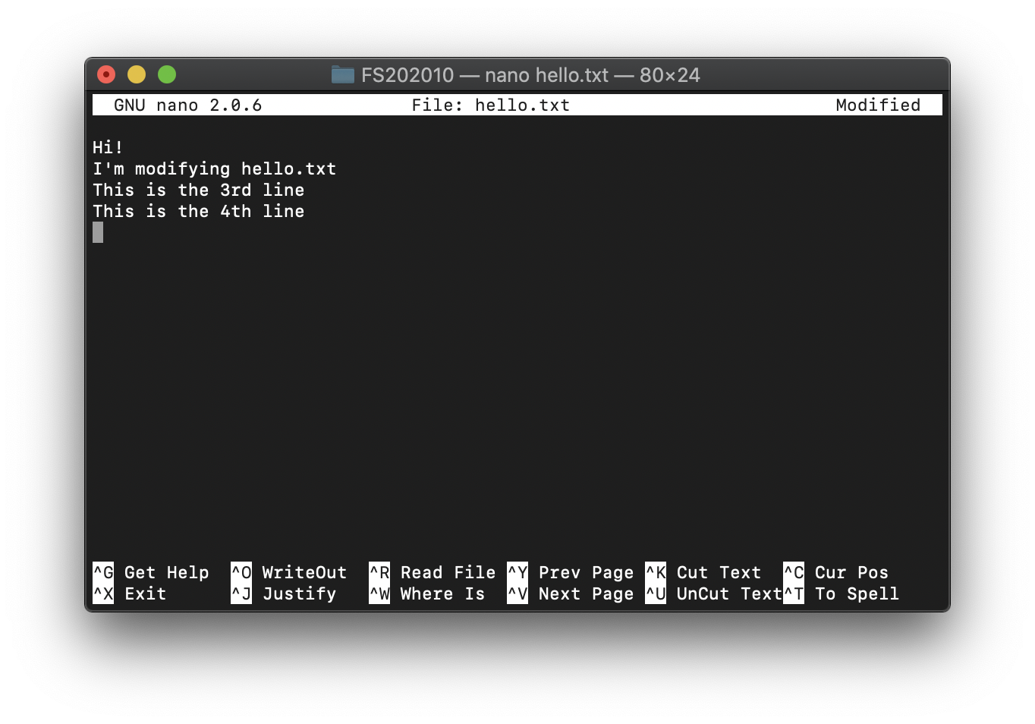
Basic Commands - nano
T
nano: allows to modify a file. Opens a mini text editor inside the terminal.
At the bottom, using Ctrl + the letter will allow you to save, close, cut the file.
To save, Ctrl + O
To exit, Ctrl + X

Slide 30
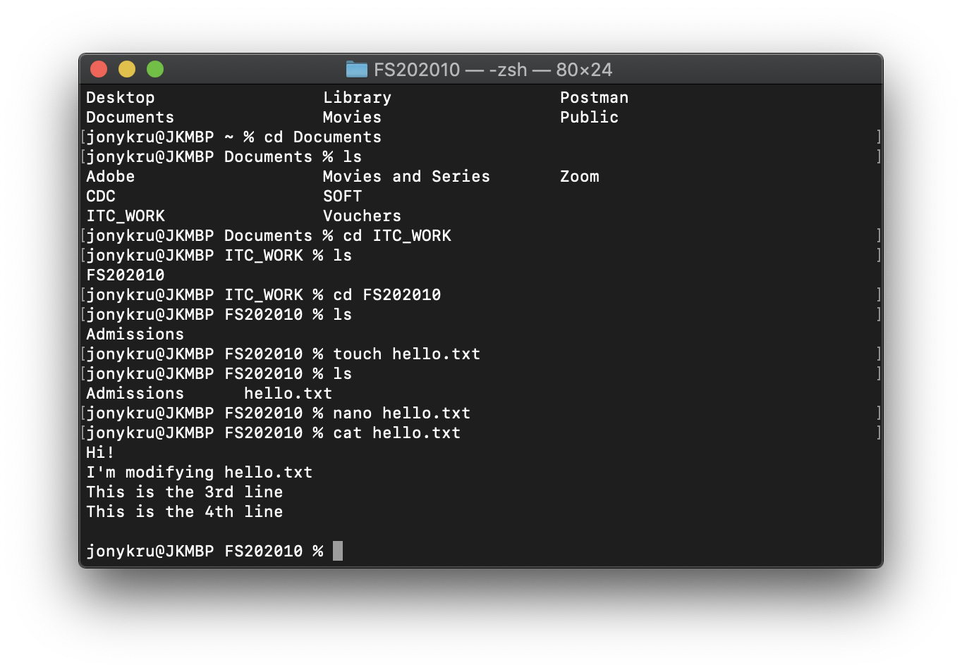
Basic Commands - cat
T
cat: reads a file
At the bottom, using Ctrl + the letter will allow you to save, close, cut the file.
To save, Ctrl + O
To exit, Ctrl + X

Slide 31
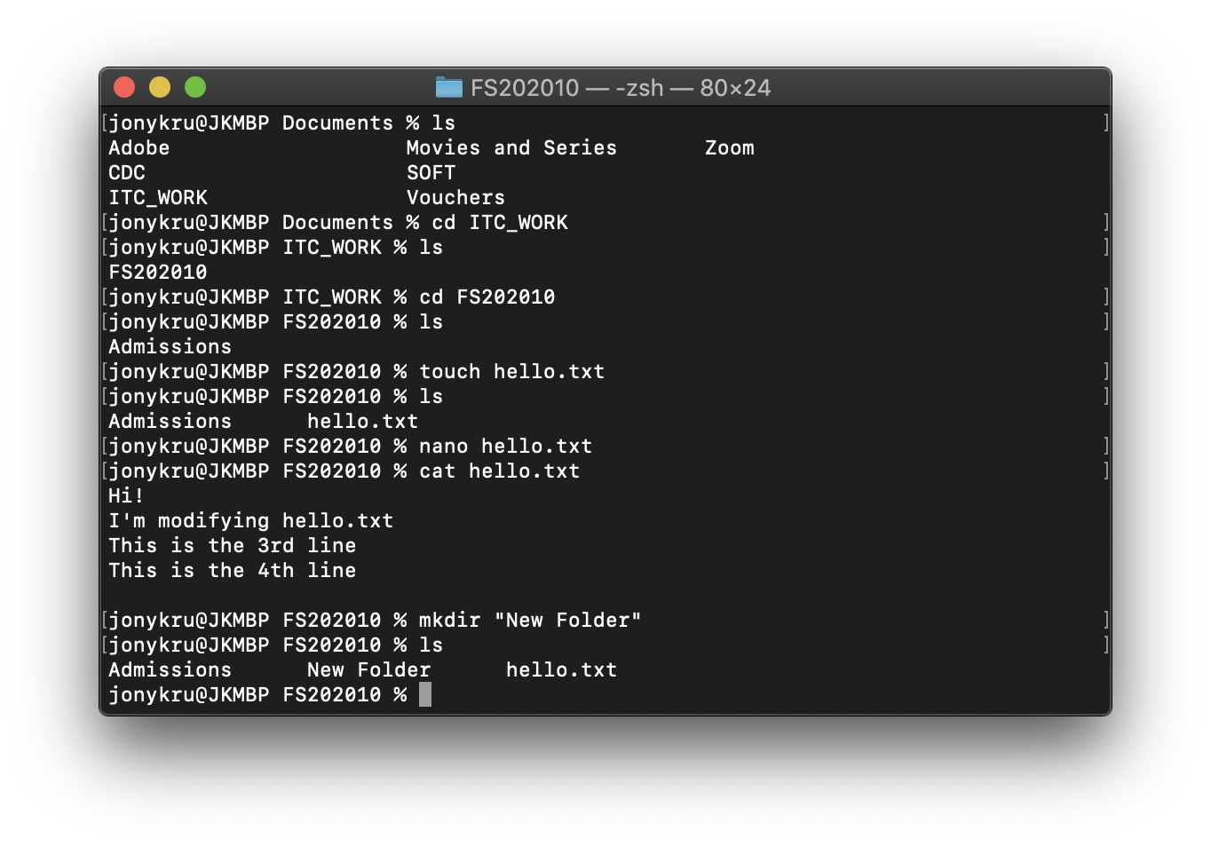
Basic Commands - mkdir
T
mkdir: creates a directory

Slide 32
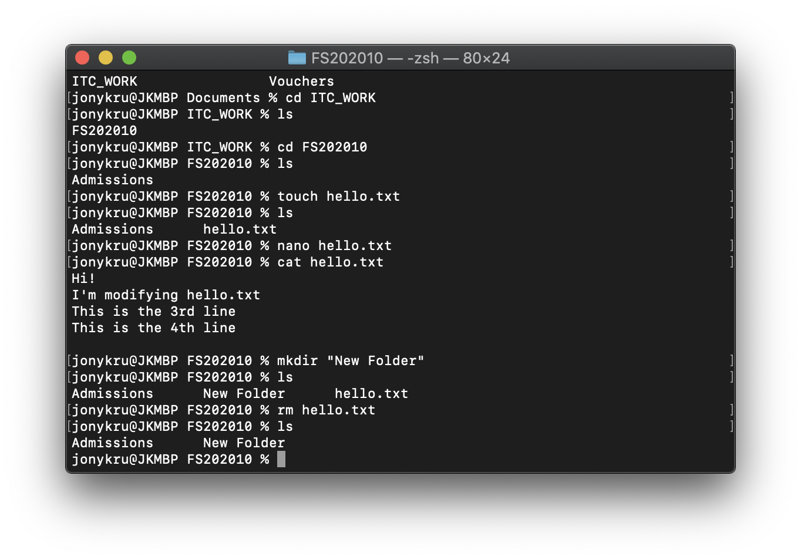
Basic Commands - rm
T
rm: removes a file or directory. Carefull! Can't be undone

Slide 33
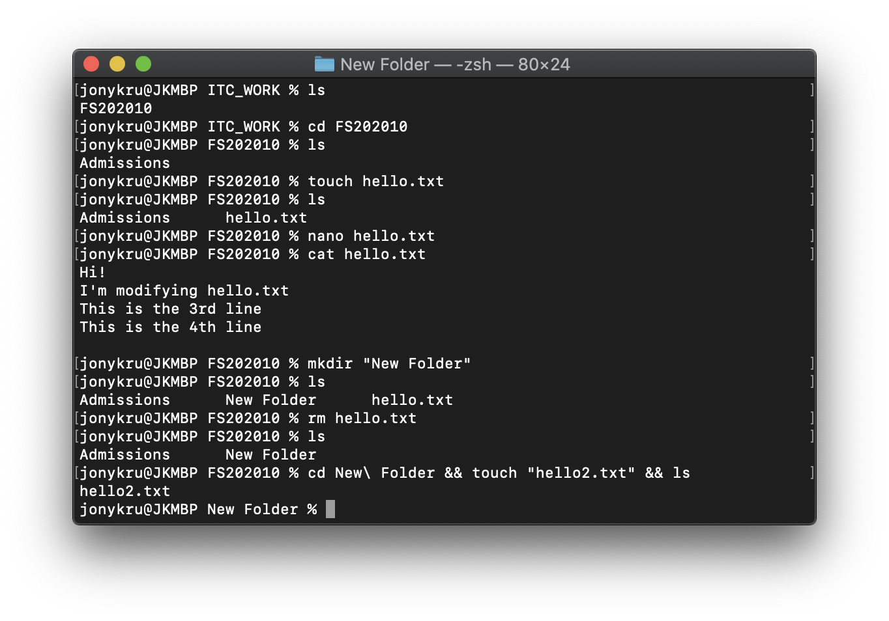
Basic Commands - concatenating
T
&&: allows to concatenate commands.

Slide 34
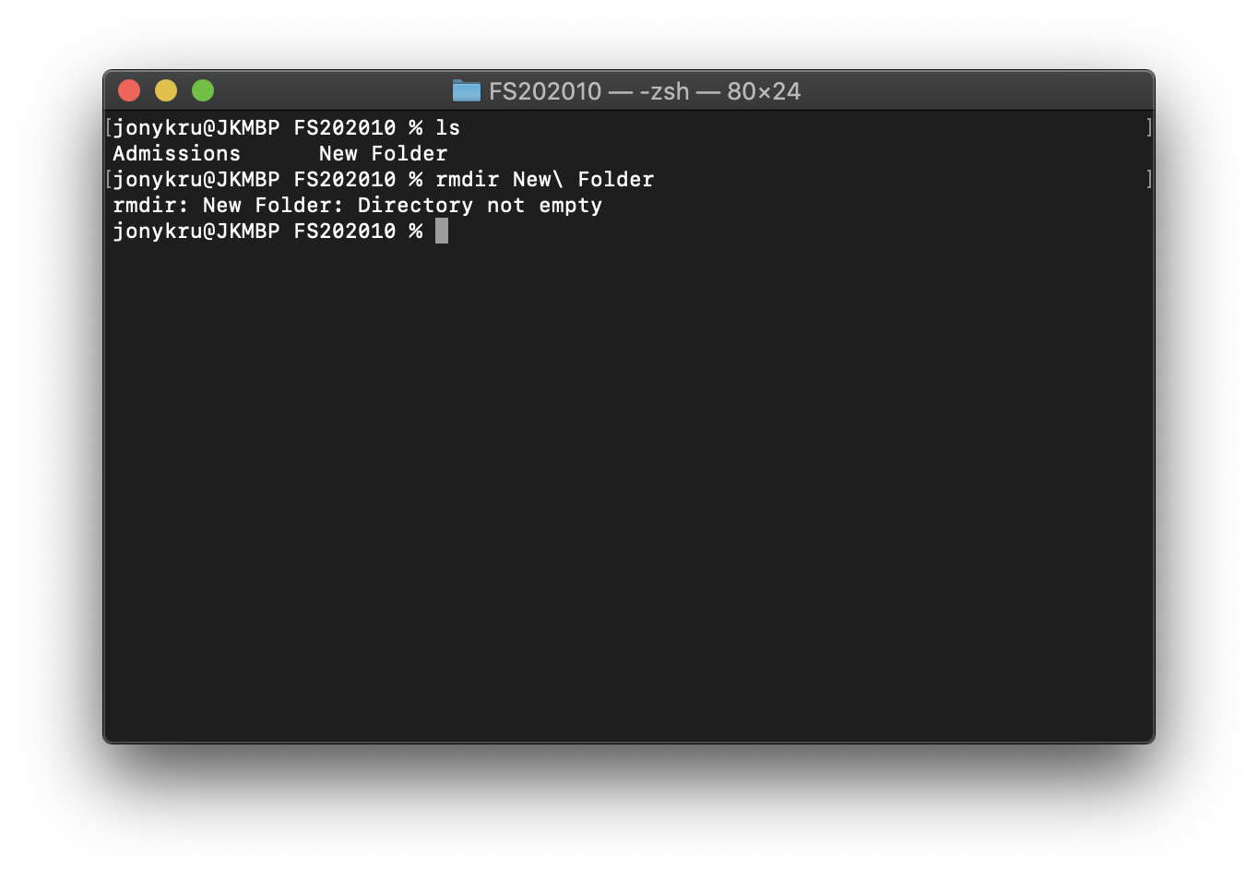
Basic Commands - rmdir
T
rmdir: removes an empty folder. Folders that they are not empty won’t be deleted.

Slide 35
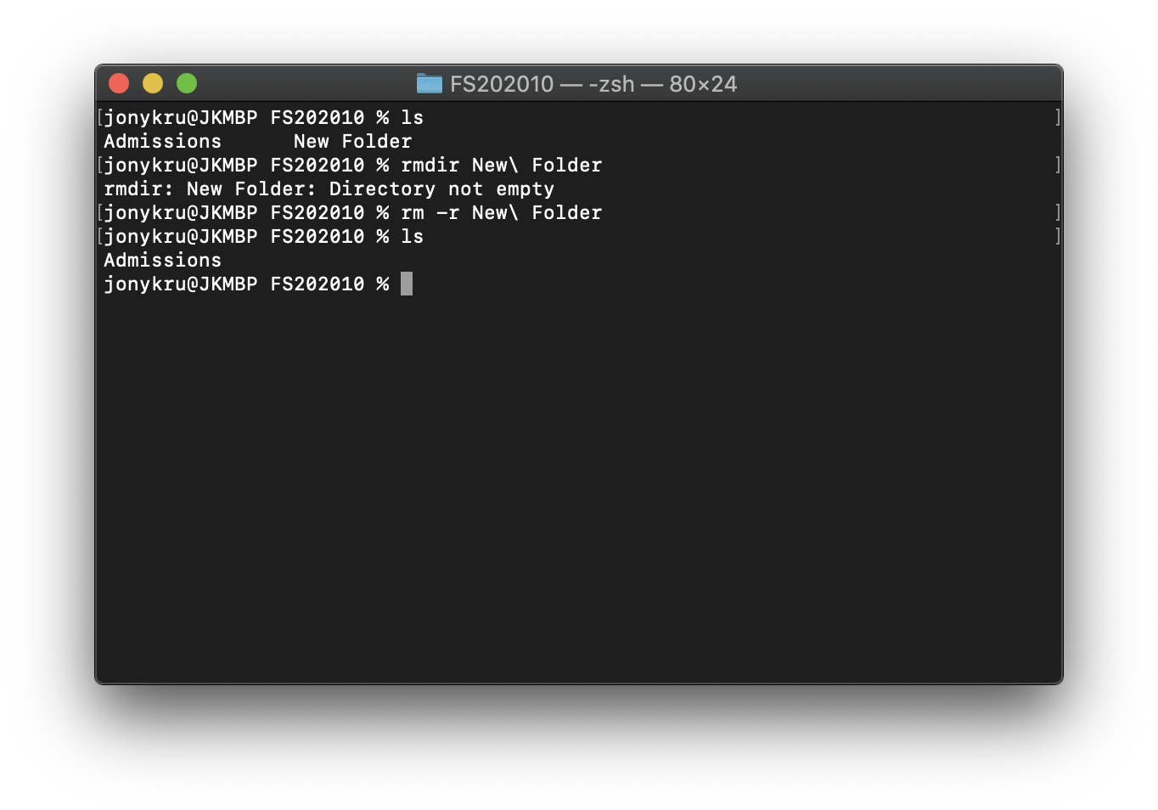
Basic Commands - rm -r
T
rm -r: the -r it is an option from rm. It means to remove recursively, so it will remove the folder + its contents

Slide 36
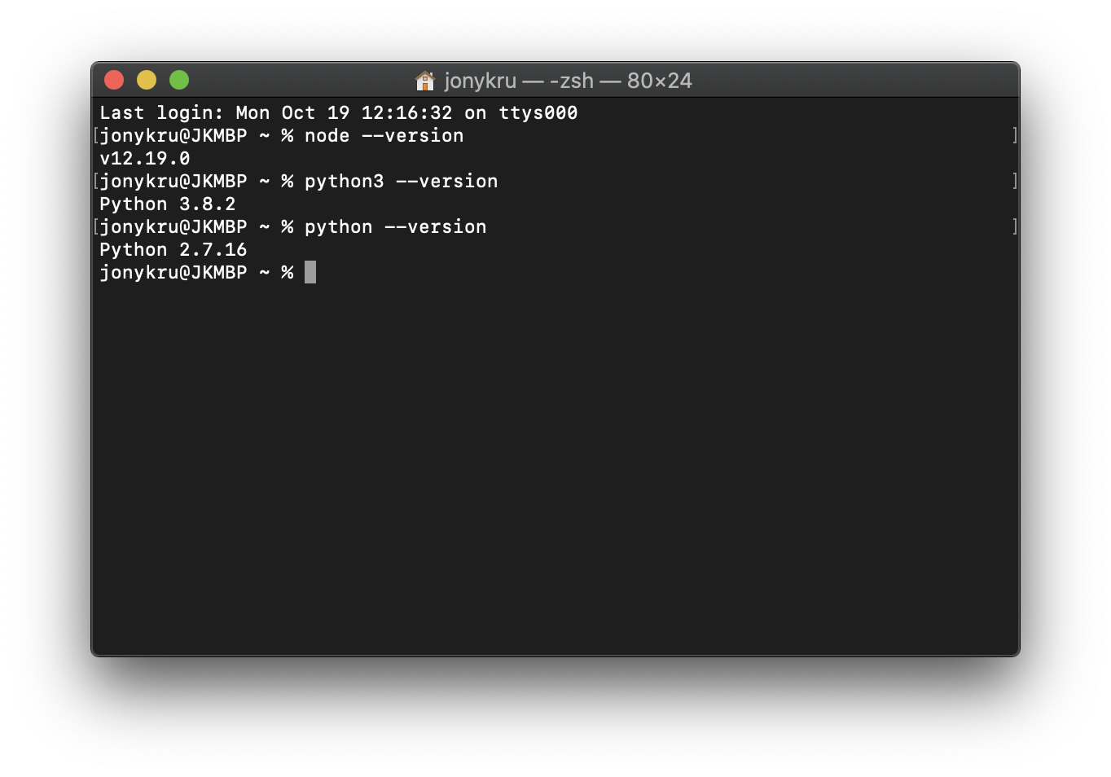
Basic Commands - version
T
-- version: you can write the name of a program, add --version to check the version and if it is installed

Slide 37
Wrapping up
T
What is a Terminal Window and its different ways to call it.
What are the advantages on learning how to use some commands.
How to open it
How to run basic commands
Next: Install some programs. You might need to use the terminal to do so.

Slide 38
Installations
T
MAC OS X:
Homebrew. You will need it to install other packages, like GIT.
https://brew.sh/
WINDOWS:
Git Bash. Comes as part of Git.
ALL OS:
Visual Studio Code: https://code.visualstudio.com/
Git: https://git-scm.com/downloads
NodeJS (Use the LTS Version): https://nodejs.org/en/
MongoDB: https://www.mongodb.com/try/download/community

Slide 39
Resources
T
Bash Documentation:
https://www.gnu.org/software/bash/manual/bash.html#What-is-Bash_003f
Bash Tips:
https://dev.to/awwsmm/101-bash-commands-and-tips-for-beginners-to-experts-30je
Bash Basic Commands:
https://www.educative.io/blog/bash-shell-command-cheat-sheet

